Slide 1
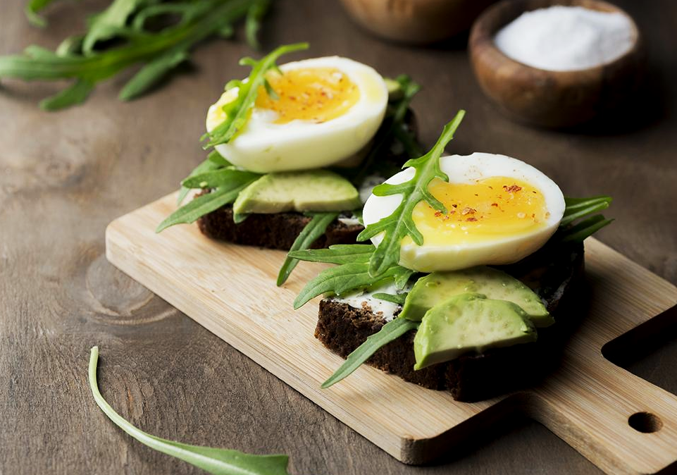
Counting Calories
LIU SHAOMIN
LU ZHIHAO
MEKALA HOSUR
MICHAEL NG
MING YIFAN

Slide 2

HOW CALORIE CONSUMPTION CAN HELP US UNDERSTAND CUSTOMERS

Slide 3
TABLE OF CONTENTS
01
02
Product Recommendation
Item Placement
How might we better recommend products to our customers?
How might we arrange products for a more convenient shopping experience?

Slide 4
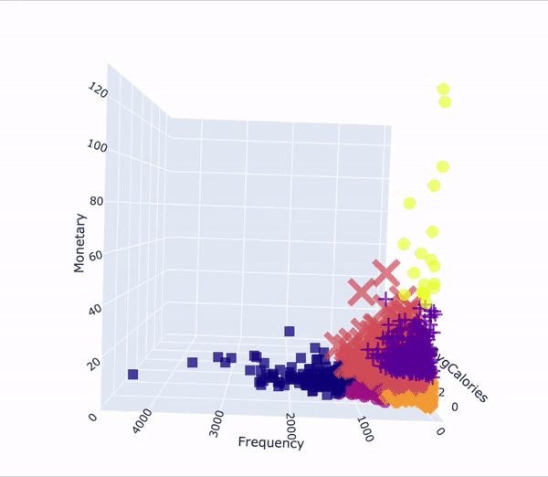
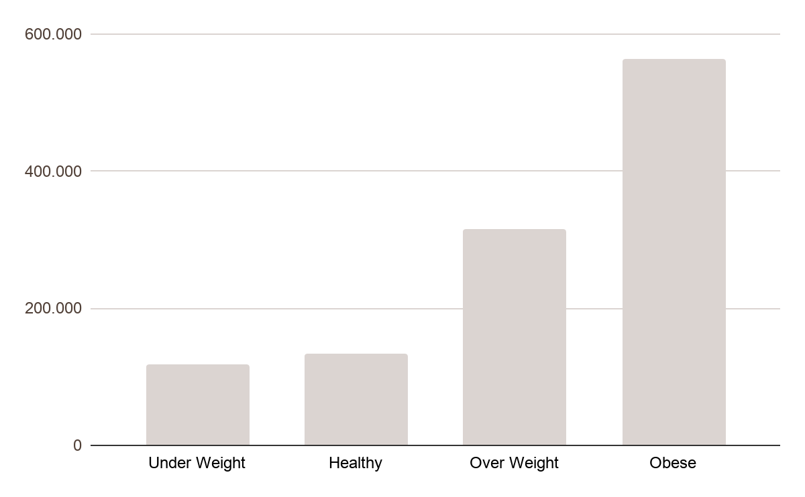
Differences in caloric consumption
140.000
12,000
25
Calories by BMI normalised by family size
Average user servings per deal
Registered bussinesses
Total app downloads
Notes:
FAT PEOPLE BUY MORE CALORIE DENSE FOOD AND THUS SHOP DIFFERENTLY
Explain why is it signifcant to cluster by caloric consumption

Slide 5
CLUSTERING
Relevance
Missing Data
Improves relevance of our recommendation engine’s output
Help with new shoppers with low number of data points
Speed
Reduces computation time required

Slide 6
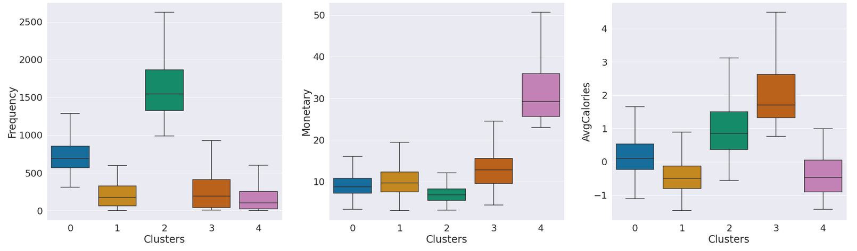
VENUS
US
5 CLUSTERS
Venus has a beautiful name and is the second planet from the Sun
Identified 5 different clusters that vary in terms of spending habits and caloric consumption

Slide 7
Personal Recommendation System
Customer profile | Recommendation Principle | Similarity
Find the cluster of the targeted customer based on Frequency, Monetary and Calories |  | Find the most similar customer based on historical consumption records

Slide 8

Recommendation Engine--Technical Details
Finds a subset of users who have similar tastes and preferences to the target user and use this subset for offering recommendations
Main approaches: User based and item based
Basic assumptions:
Users with similar interests have common preferences
Sufficiently large number of user preferences are available
Similarity:
Cosine similarity between the amount of money spending on each products
Comparing with 20 most similar customers
Error elimination:
Eliminate the influence of zero in vector product

Slide 9
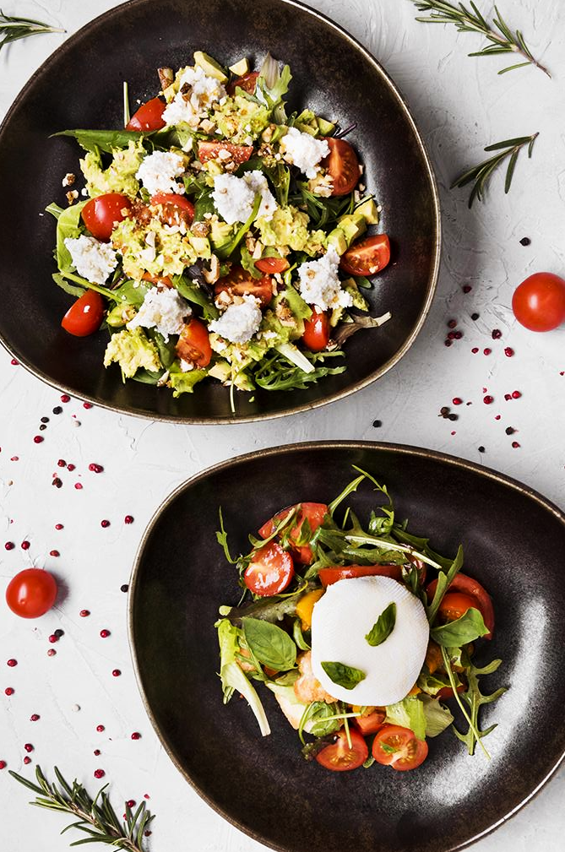
Recommendation Engine
Spirits · Beer · Rice
Biscuits · Wine · Cooking Oils
Frozen Food · Tonic Food Drink · Snack
Milk Powder · Frozen Food · Biscuits
Rice · Biscuits · Tonic Food Drink
Rice · Biscuits · Cooking Oils
Notes:
225110102
Income >5000
Central Malay
Matured Families
Urban
1-3 Member HH

Slide 10
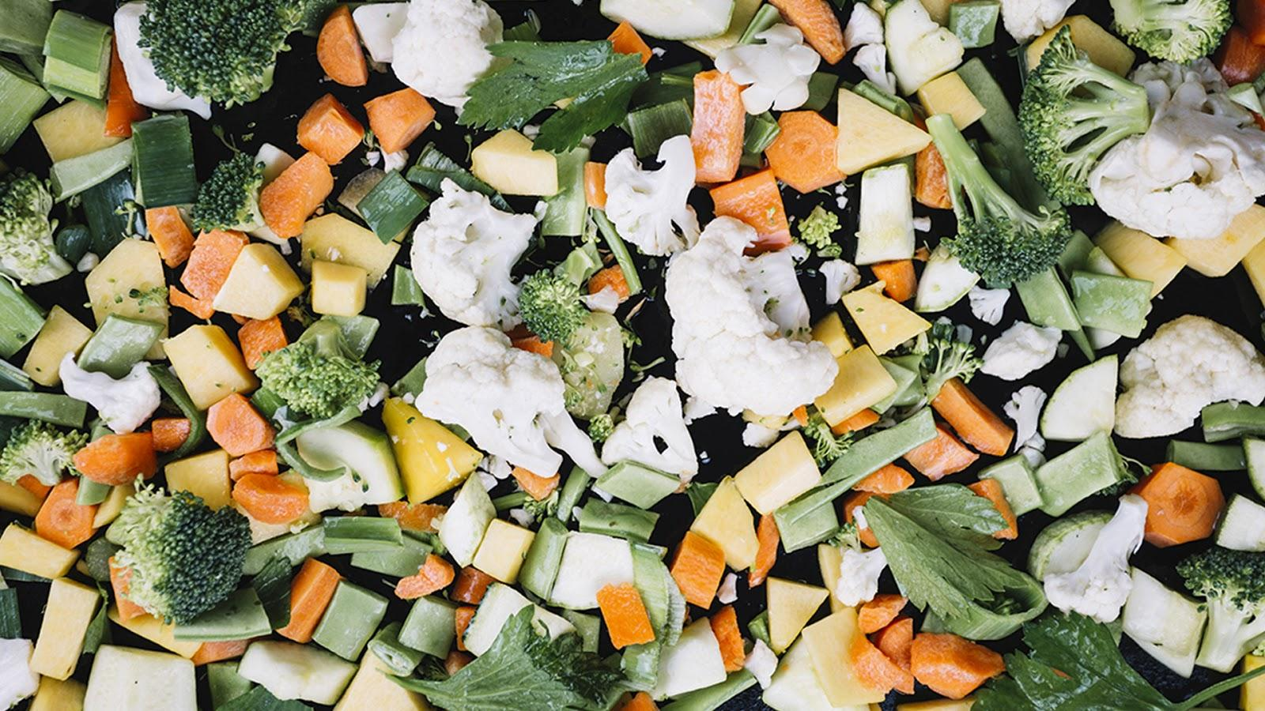
$108,142.79
Potential increase in quarterly revenue from engine

Slide 11
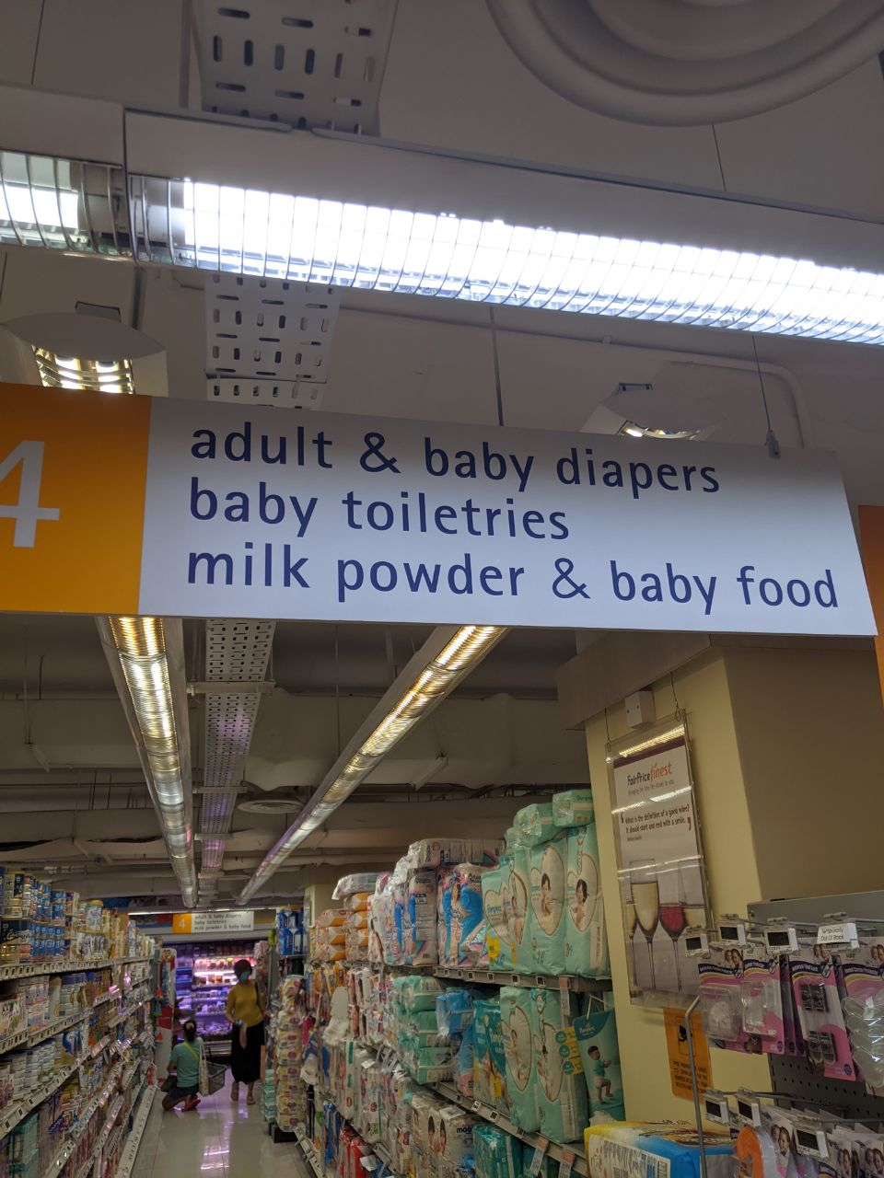
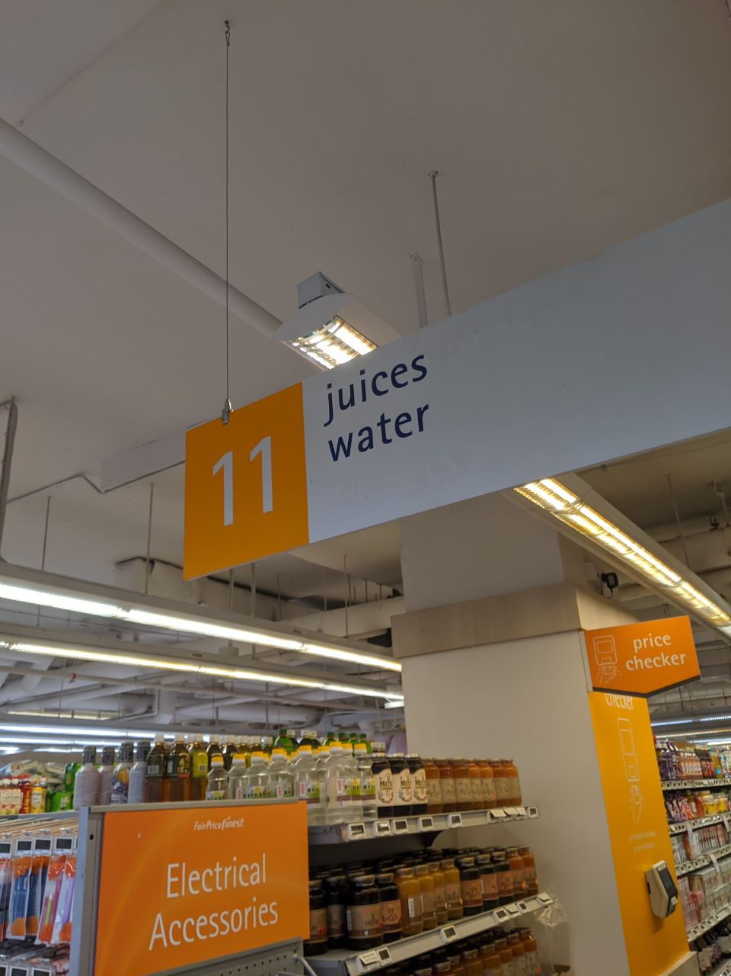
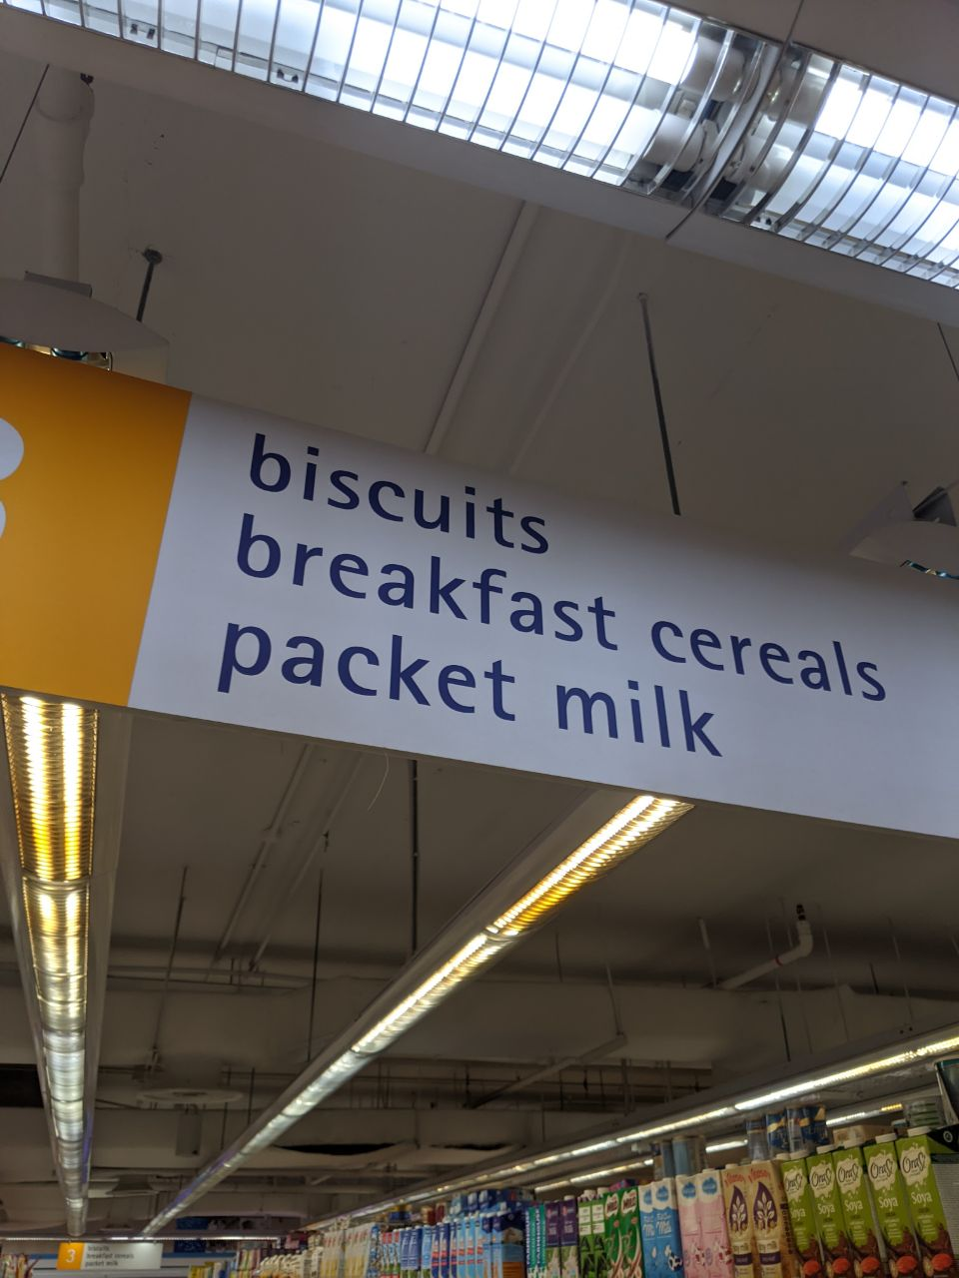
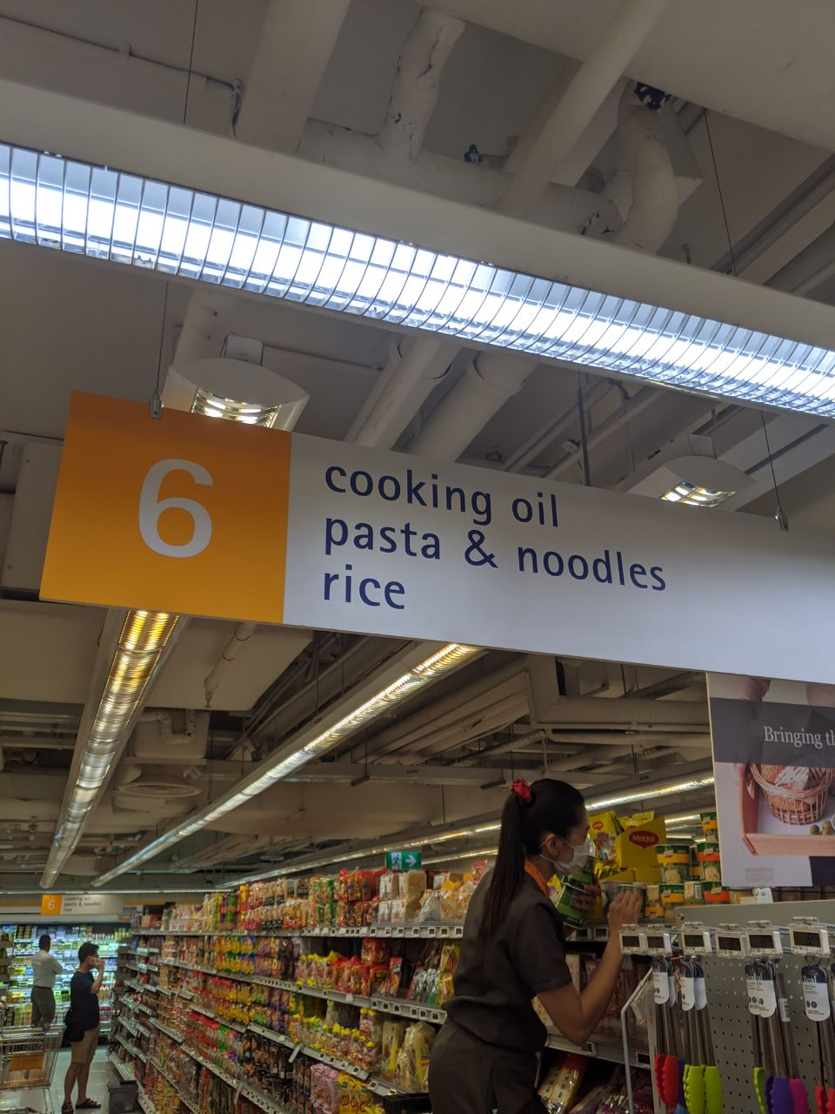
PRODUCT PLACEMENT
Discover products that are more associated to each other for policy making

Slide 12
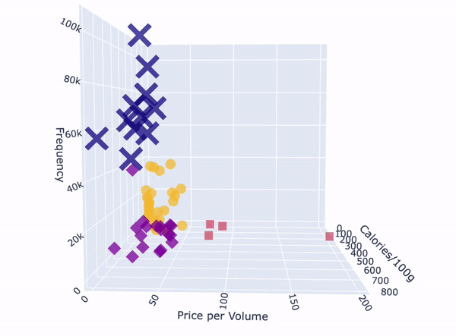
Notes:
With only the price and frequency of purchase, we see that there is no significant cluster observable in the categories, but after adding the third dimension of the calrific content of each category, we see that there is no some idendifieable categories.
The following are the clusters that we have identified from the catergories, we see that many of the catergories are closely related according to their calorific content, price and frequency purchased by the customers, In the past, we have tried categorising the items using RFM models,
RFM model likely cluster items that that are similarly high in recency, frequency and monetary together, meaning it is likely to group items that are more popular with those that are more popular, using this method, we eliminate the preference of the consumers but look at purely the charateristics of the products, to classify them, independent from consumer preferences.

Slide 13
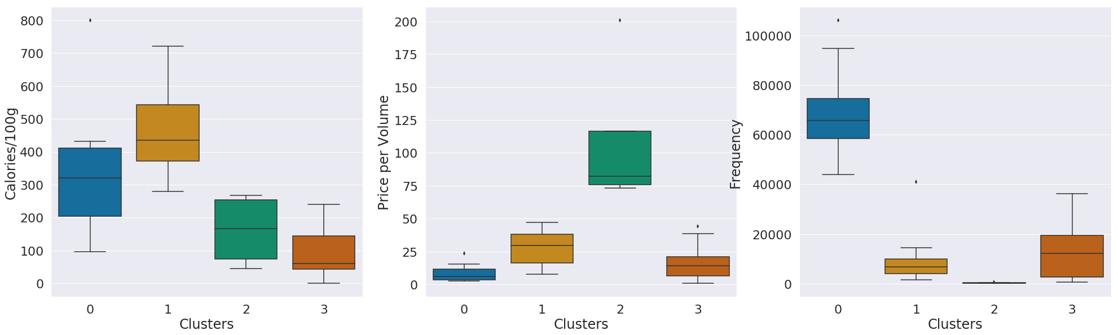
CLUSTERS
Notes:
With only the price and frequency of purchase, we see that there is no significant cluster observable in the categories, but after adding the third dimension of the calrific content of each category, we see that there is no some idendifieable categories.
The following are the clusters that we have identified from the catergories, we see that many of the catergories are closely related according to their calorific content, price and frequency purchased by the customers, In the past, we have tried categorising the items using RFM models,
RFM model likely cluster items that that are similarly high in recency, frequency and monetary together, meaning it is likely to group items that are more popular with those that are more popular, using this method, we eliminate the preference of the consumers but look at purely the charateristics of the products, to classify them, independent from consumer preferences.

Slide 14
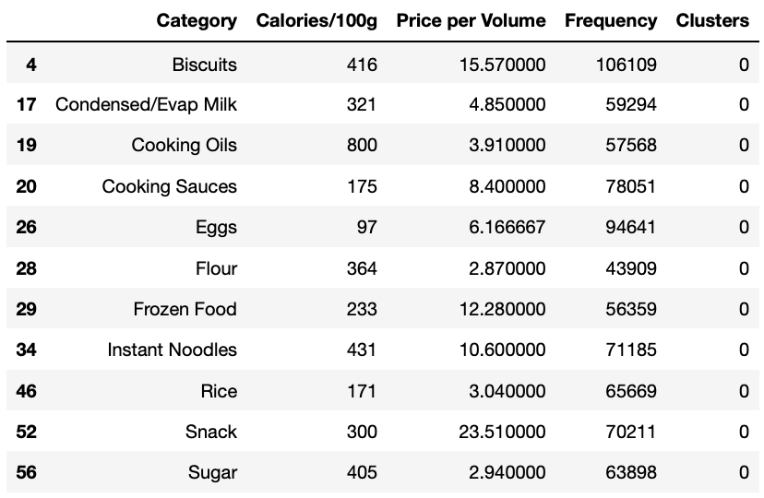
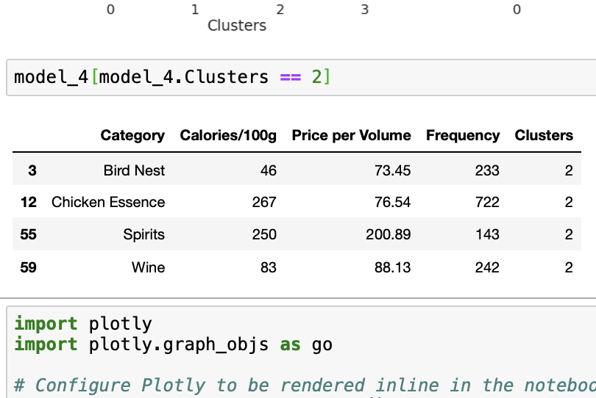
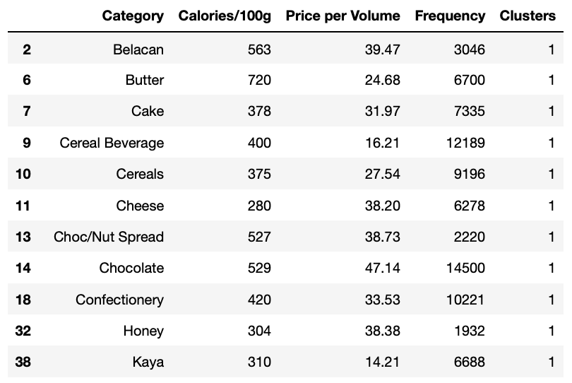
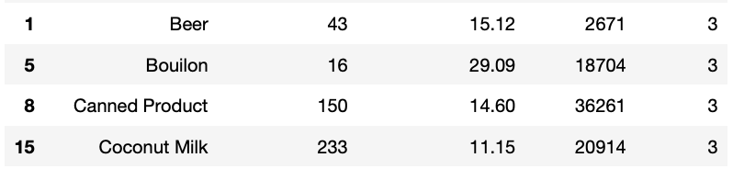
PRODUCTS

Slide 15
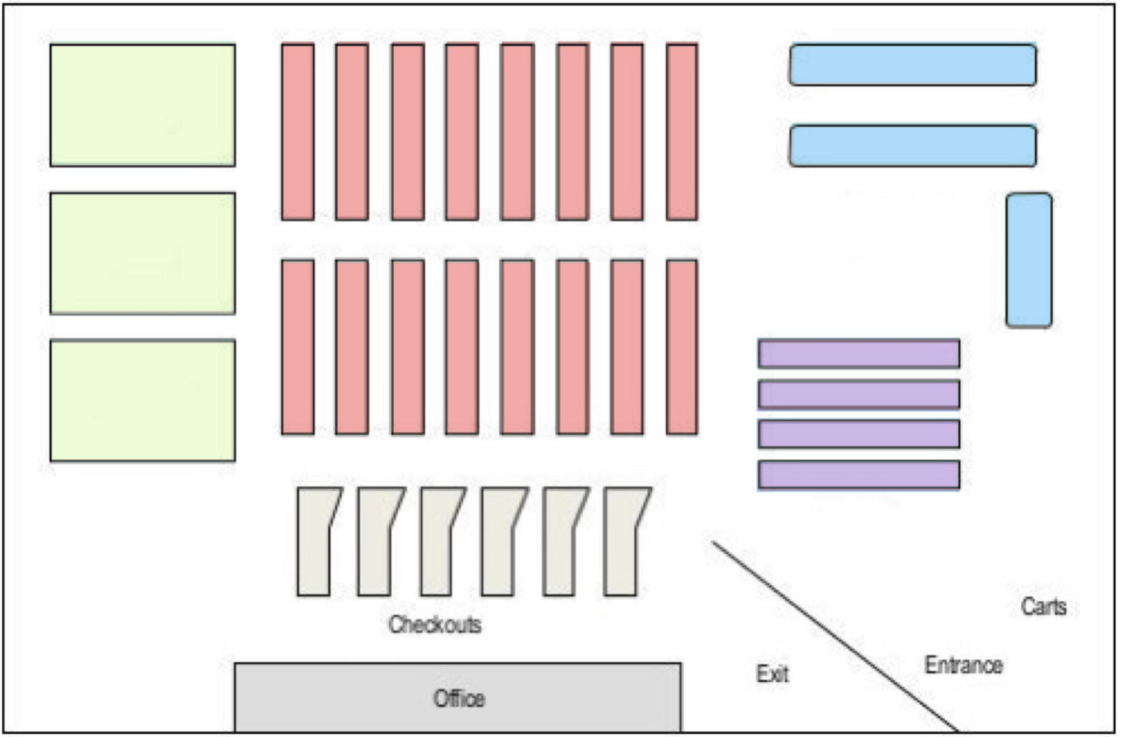
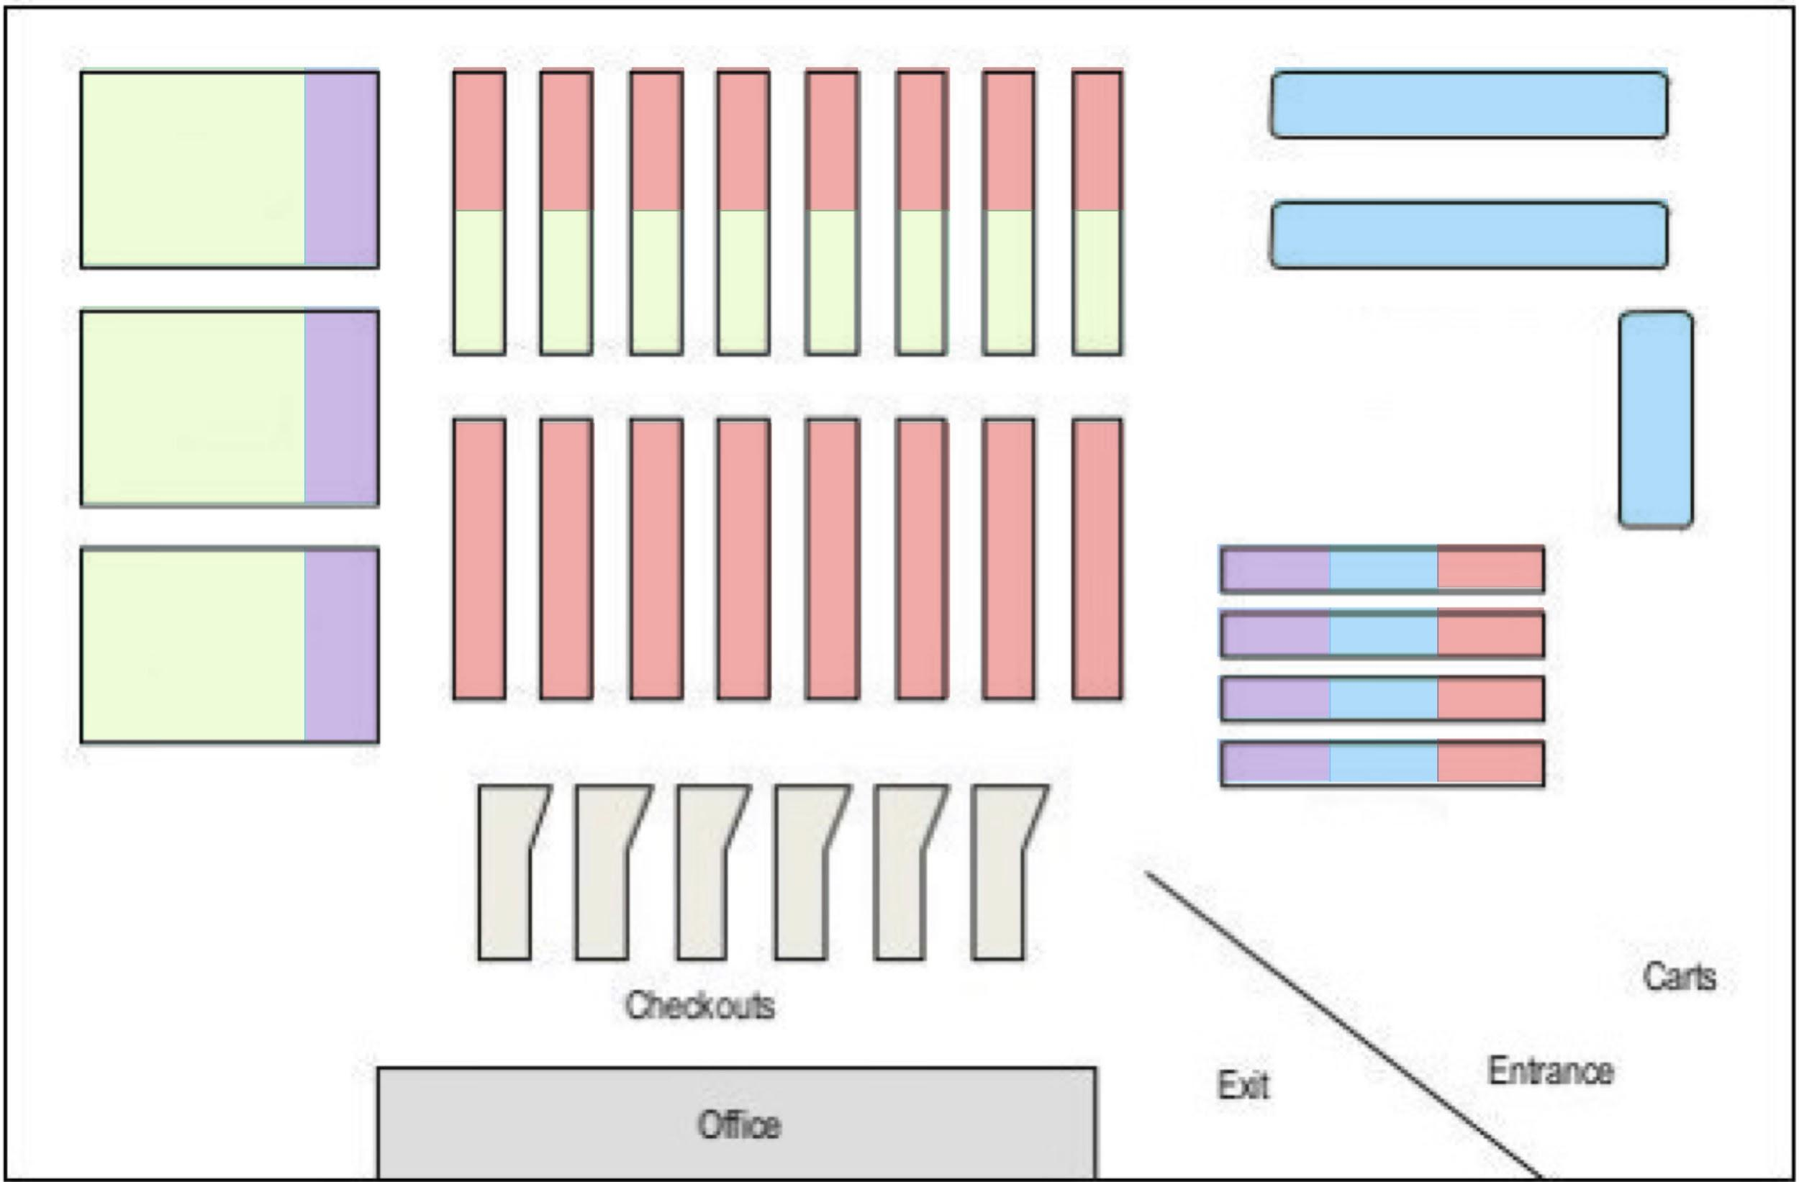
PLACEMENT TRADEOFF
CONVENIENCE
Customers will be able spend less time looking for items
CUSTOMER ATTENTION
Customer might pick up more items when they spend more time in the store
Notes:
We can see there is a tradeoff here between convenience and customer attention, the more convenience our store is, the less time the customer will spend with us but if we are able to allow the customers to spend more time with us, we might get them to spend in the shop.
One typical way of arrangement is to put them according to the category. But using our clustering analysis. We have identified items that are higher in frequency of purchase, and therfore we can devise a cocktail arrangement that place items that we want to promote together with items with higher purchase frequency.

Slide 16
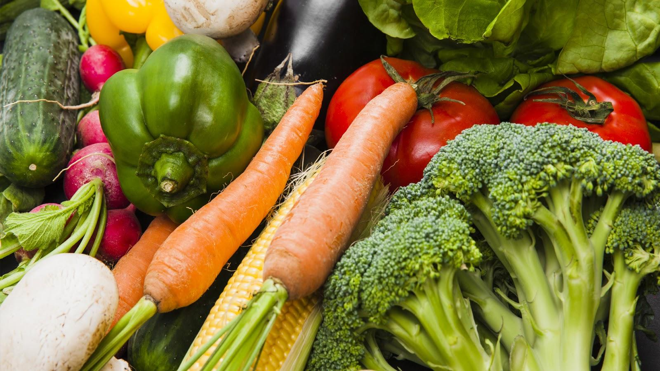
THANK YOU

